Slide 1

Presentation on Flutters Components
Presented By Sulav Poudel

Slide 2
Widgets
In Flutter everything is a widget. Widget are like legos and are the building blocks of Flutter Apps. We can combine them together to build an amazing apps with complex user interface.
The central idea is that you build your UI out of widgets. Widgets describe what their view should look like given their current configuration and state.
Based on the values that are passed into widgets they change the apperance.

Slide 3
Steps Needed to Be Done Before Using Widgets in Flutter
First thing we have to do is import material.dart which contains all the widgets we’re going to use.
Next create main function which is entry point app and calls run app passing in a stateless widget called myapp.
In Flutter we have two different types of widgets
Stateless Widget
Stateful Widget

Slide 4
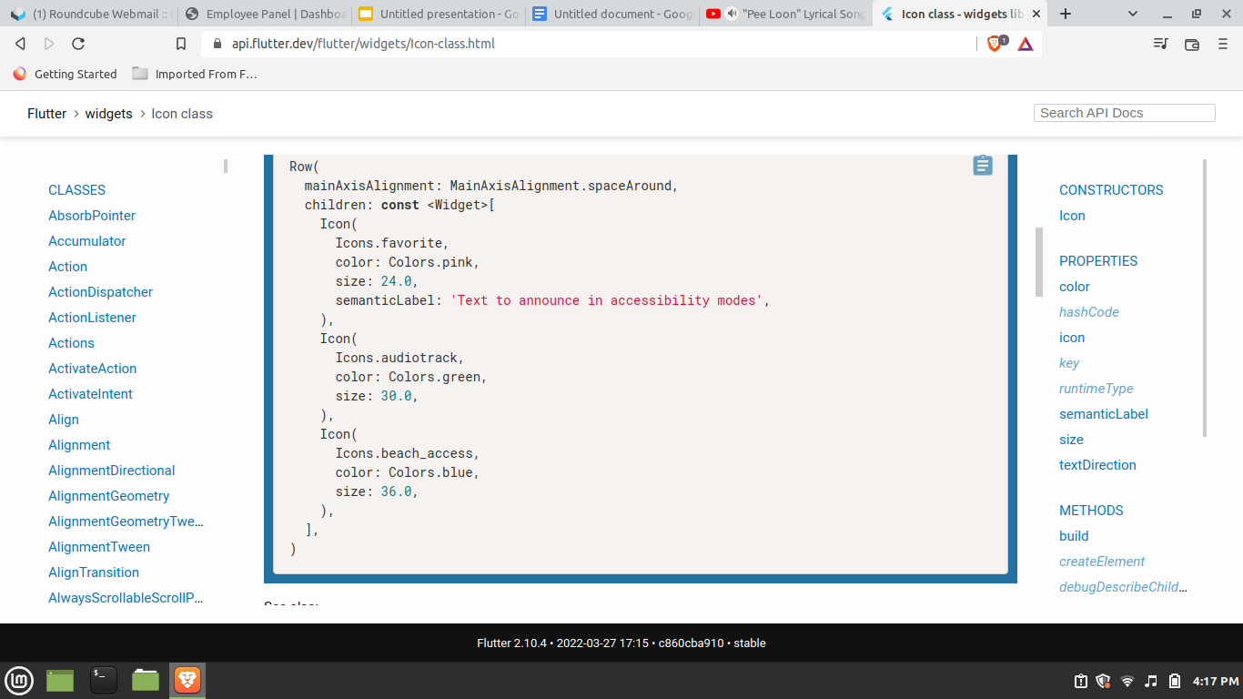
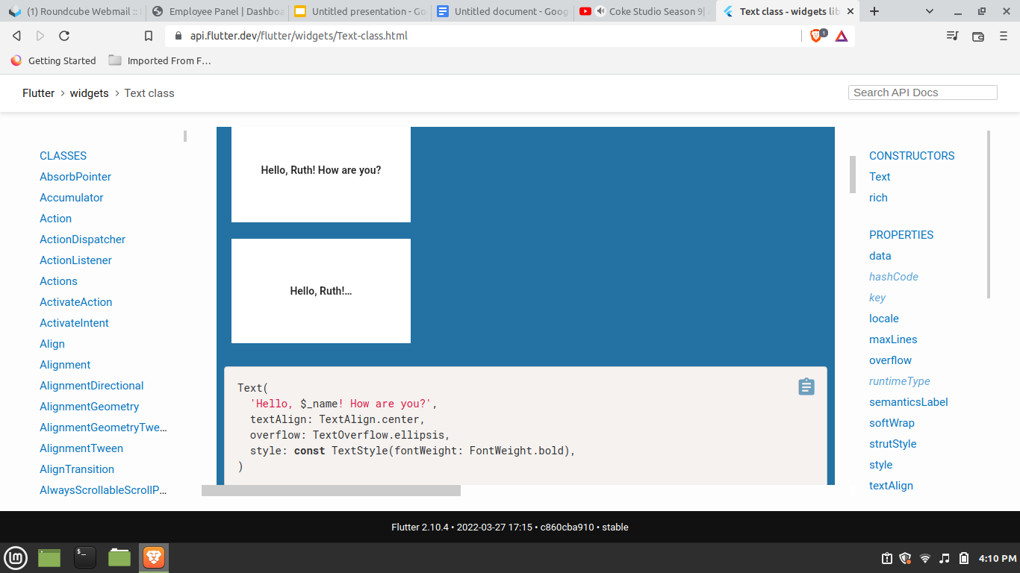
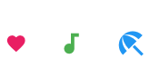
Stateless Widget
Stateless Widgets are the widgets that never change. For Example Text and Icon widgets

Slide 5
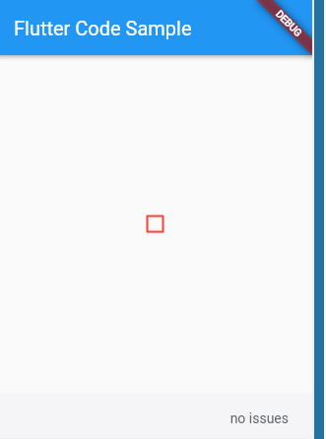
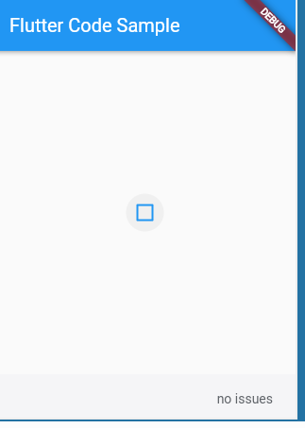

Stateful Widget
Stateful Widgets changes the appearance when the user interacts with them or they receive data. For Example checkboxes,text field,sliders.
These Widgets need to maintain their current state when the user interacts with them.

Slide 6
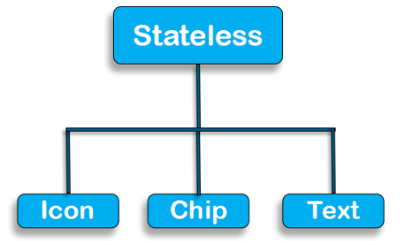
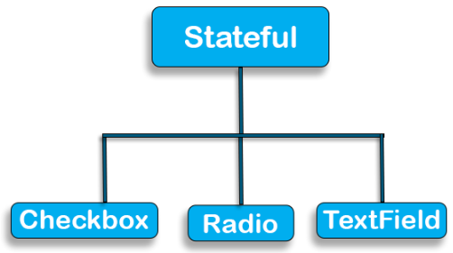
When to Use?
Stateless Widget
In Stateless widget, The “build” method can be called only ONCE while the app is in action, which is responsible for drawing the widgets on to the device screen.
Stateful widgets have a mutable state, i.e., they are mutable and can be drawn multiple times within its lifetime.
They are the widgets which can change their state multiple times and can be redrawn on to the screen any number of times while the app is in action.
Stateful Widget

Slide 7
Material App
Many Material Design widgets need to be inside of a Material App to display properly, in order to inherit theme data.
Therefore, run the application with a Material App.
MaterialApp widget provides a ton of benefits that affect its entire widget subtree. This section is the beginning of our discussion of many widgets that provide helpful functionality for free.
Material App is even more convenient than Widgets App. It adds Material Design-specific functionality and styling options to your app.

Slide 8
Note:
Inside of MyApp we need to have our build method return a material app.
Material App is the backbone of flutter app.
This widgets manages our top level navigator for navigation between screens and allows us to easily keep consistent theme throughout the app.

Slide 9
Scaffold Widget
Scaffold Widget implements the basic material design visual layout structure making, adding widgets like app bars and floating action buttons easily.
We use the keyword cons so the text and icon widgets do not rebuild as they do not change.
To avoid unnecessary rebuilds to optimize performance when our widget tree renders.
It provides APIs for showing drawers, snack bars and bottom sheets.
Scaffold contains various functionality from giving an appbar, a floating button, a drawer, background color, bottom navigation bar, footer buttons,body.

Slide 10
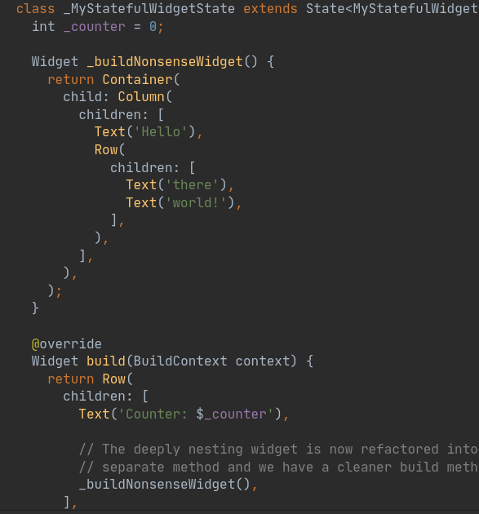
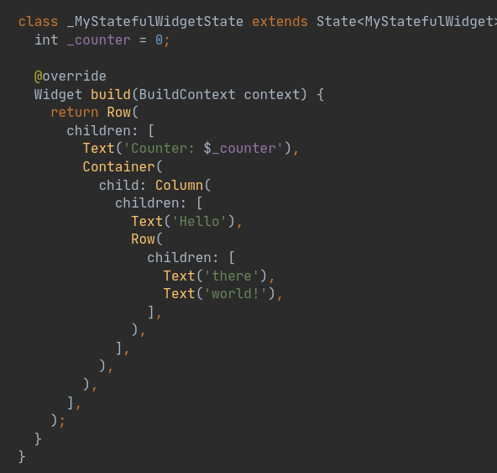
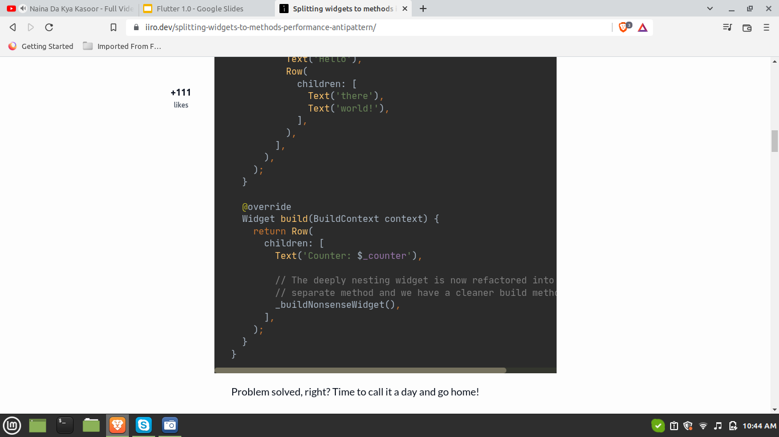
Splitting Widgets to Methods
Splitting Widgets
to
Methods

Slide 11
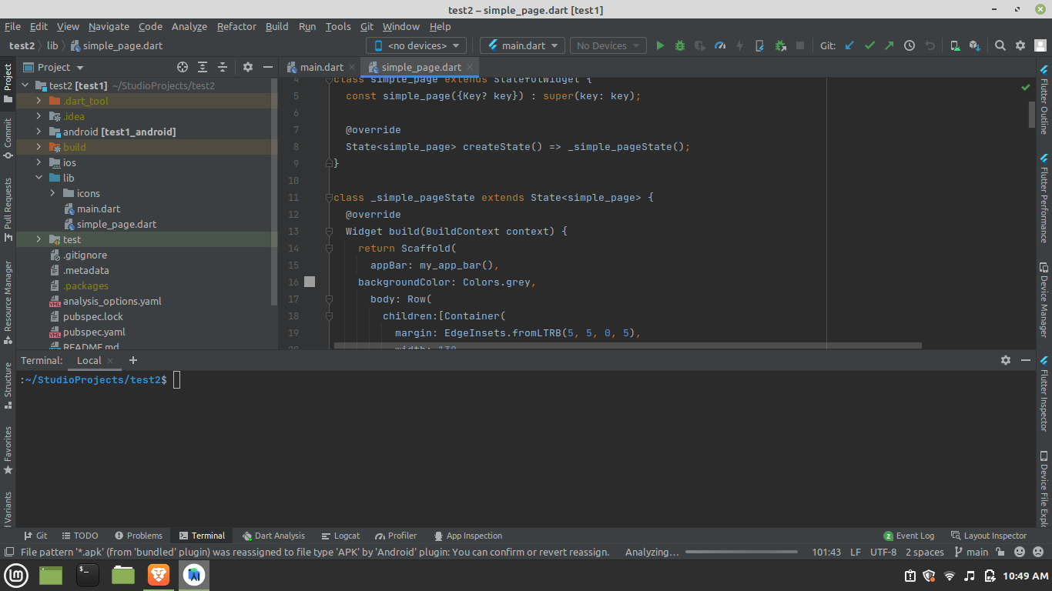
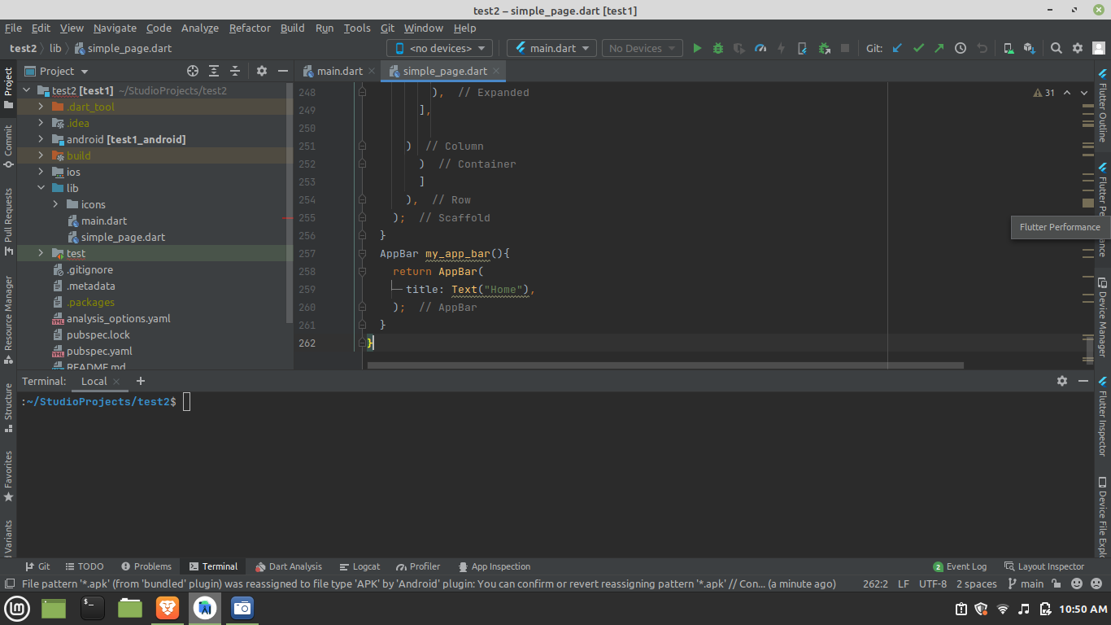

Slide 12
Naming Convention in Flutter
A naming convention is a set of rules for choosing the character sequence to be used for identifiers which denote variables, types, functions, and other entities in source code and documentation.
Dart has it’s own naming conventions for the Variables, Fields, Methods, Classes, and Packages.
Rules:
Variables and Field name will starts with Lower-Case and every Second word’s first letter will be Upper-Case like firstName, secondName, getAllColors.
Using Under-Score in the middle of the Variable or Field Name is discussed in Dart. But you can use the underscore at the beginning of a Variable or File Name and if you do so then it will be a Private Variable or Private Field and it’s Scope will be Local.

Slide 13
Class names will starts with Upper-Case letter and every second word’s first letter is also Upper-Case like
class People{
}
class ProductService{
}
class MaterialPageRoute{
}
If you want to make the class Private then use Under-Score in front of Class name. See Below :-
class _People{
}
class _ProductService{
}
class _MaterialPageRoute{
}

Slide 14
All the Libraries, Packages, Directories, and Source Files will be named LowerCase with UnderScores like lower_case_underscores.

